Slide 1



Articulating Robotic arm
Mathew Pellarin

Slide 2
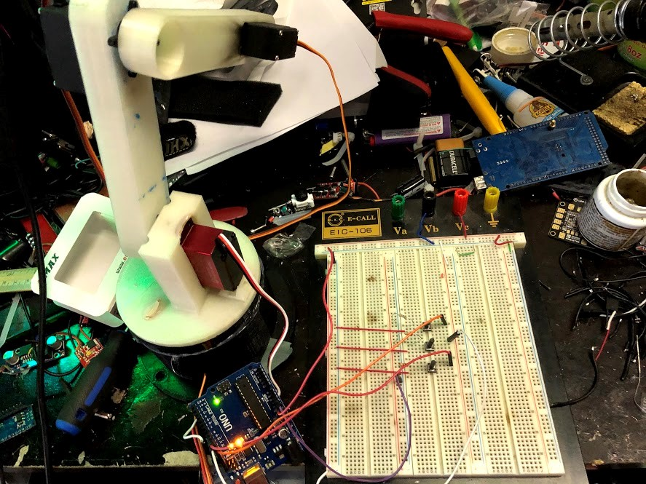
Articulating Robotic Arm
When a metal object is placed onto the conveyor the conveyor will start moving forward
The robotic arm will detect when the part ready to be picked up and will engage the electro magnet
The robotic arm pick the part up and rotate itself putting it at the unloading station.
The arm will get ready for the next part.

Slide 3
How will this be Accomplished?
The arm will be primarily made of Polylactic acid (PLA) and most parts will be 3D printed. RC Servos will make the arm have motion and an electromagnet on the head of the robotic arm.
The conveyor will be made with aluminum extrusions with custom rollers and a PVC belt. A stepper motor will be driving the conveyor forward.

Slide 4
Designs to date
As of November 19, 2019

Slide 5
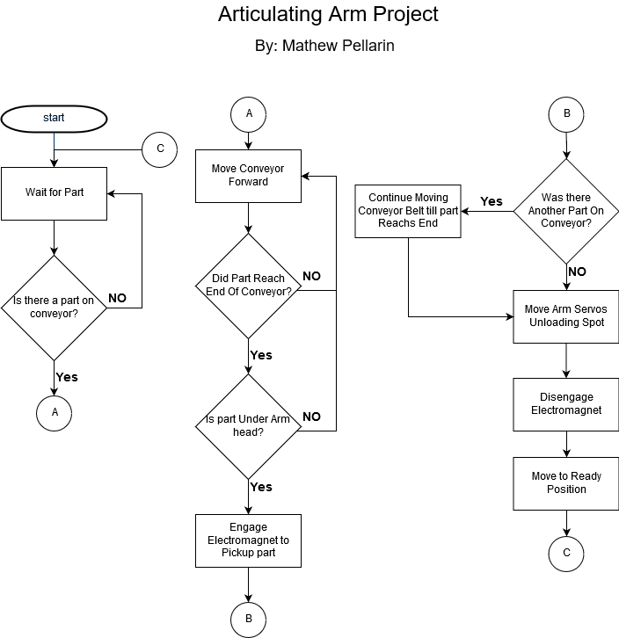
Flowchart

Slide 6
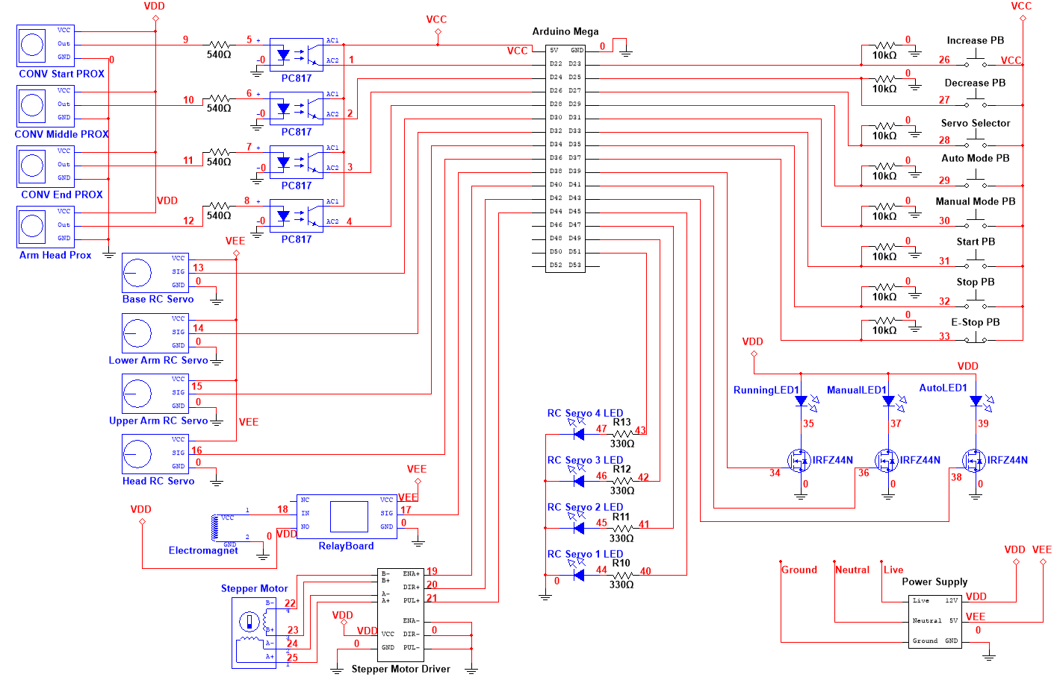

Slide 7
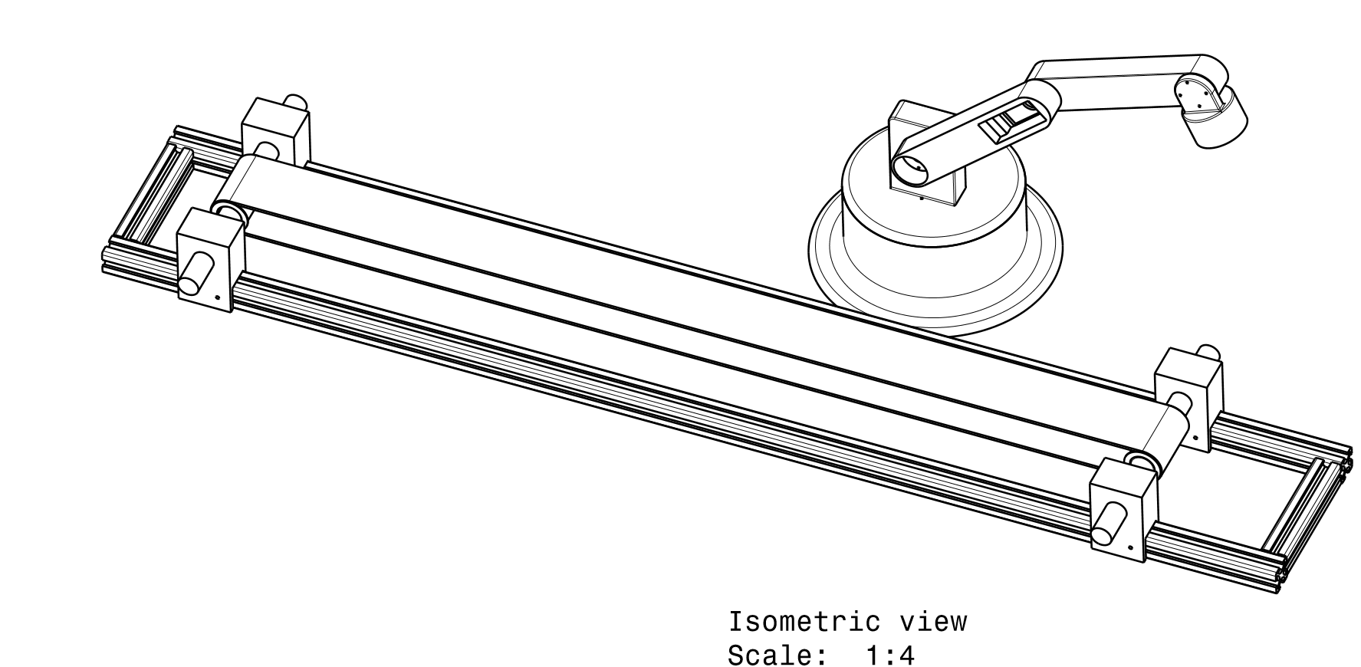
Mechanical Drawing

Slide 8
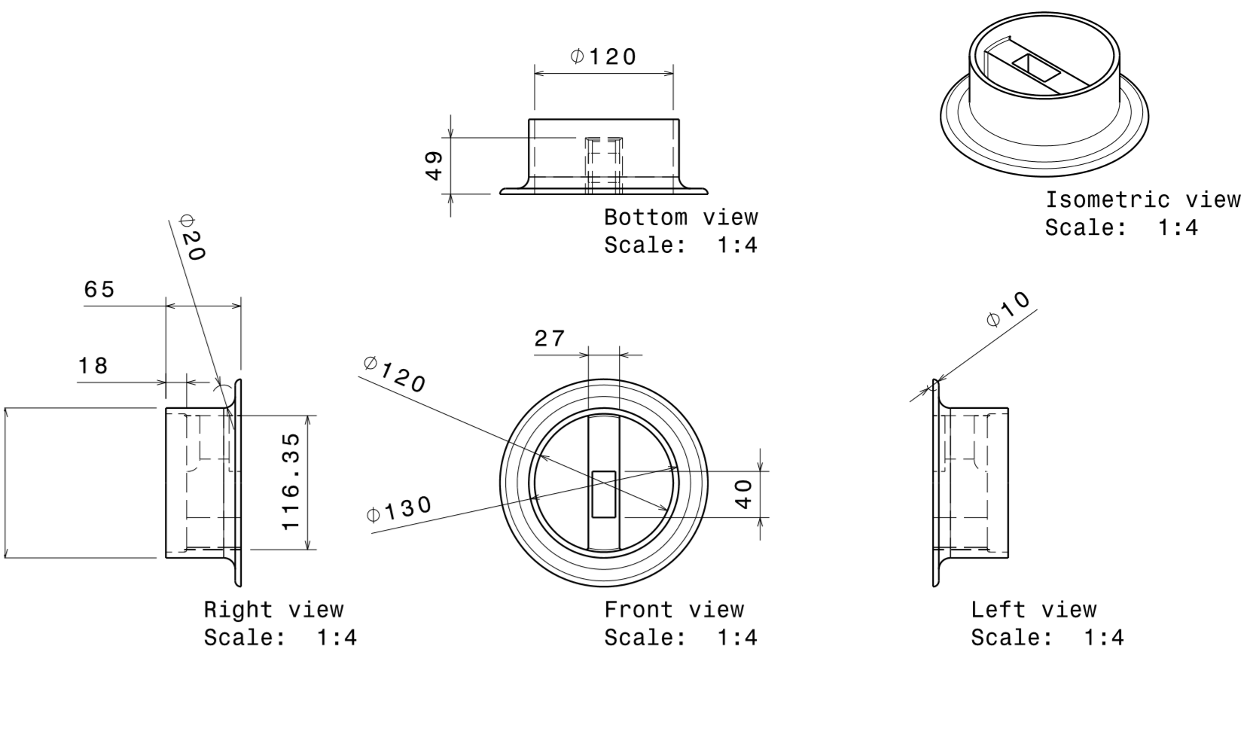
Base

Slide 9
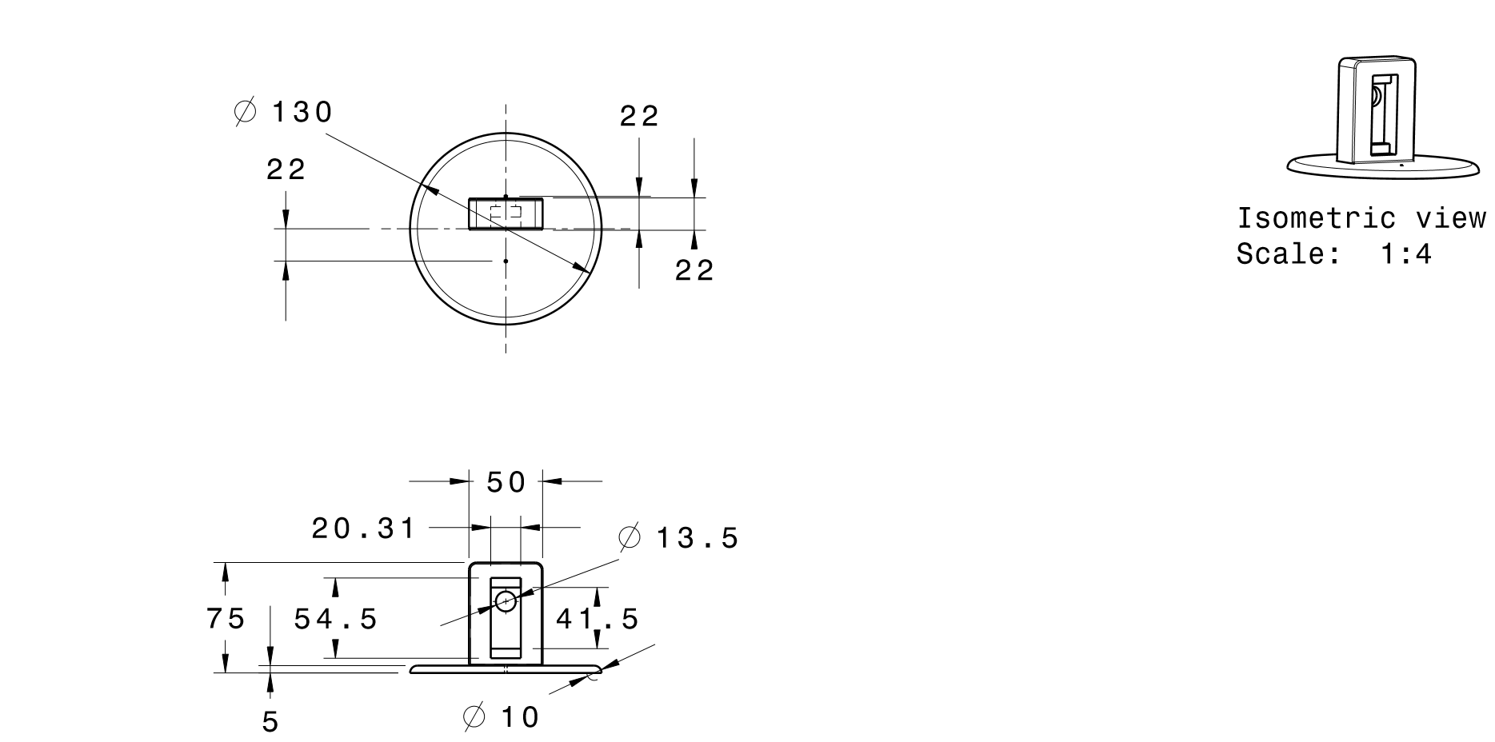
Base Top

Slide 10
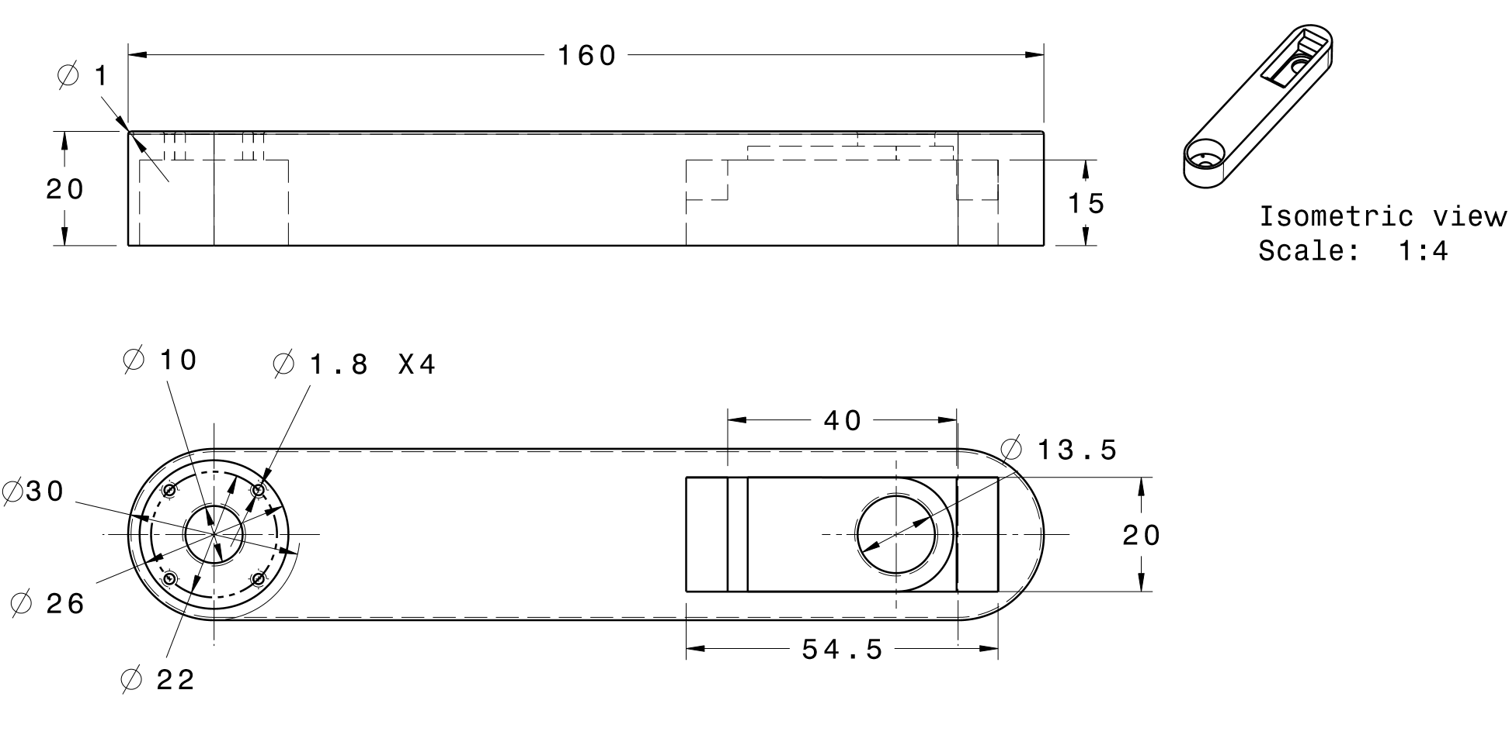
Arm

Slide 11
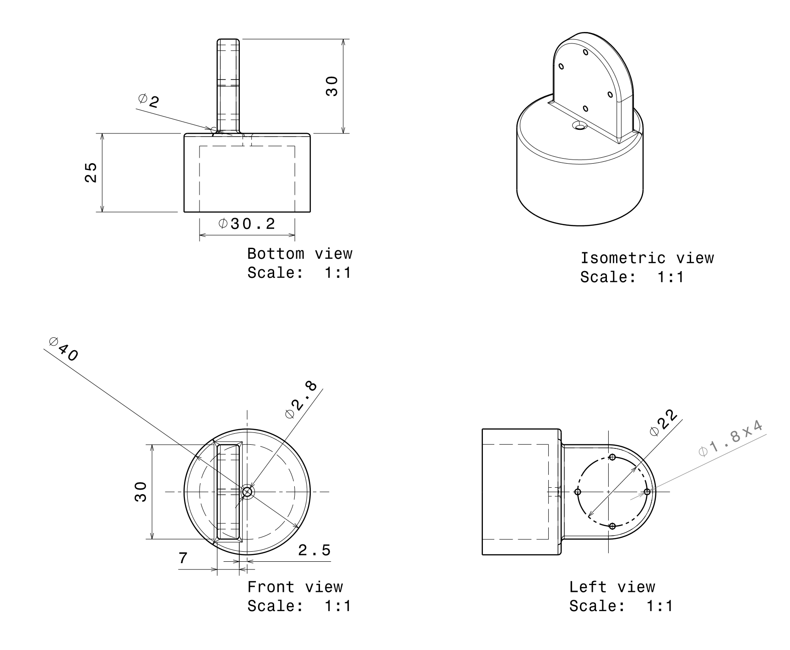
Electromagnet Holder

Slide 12
Progress to date
As of November 19, 2019

Slide 13
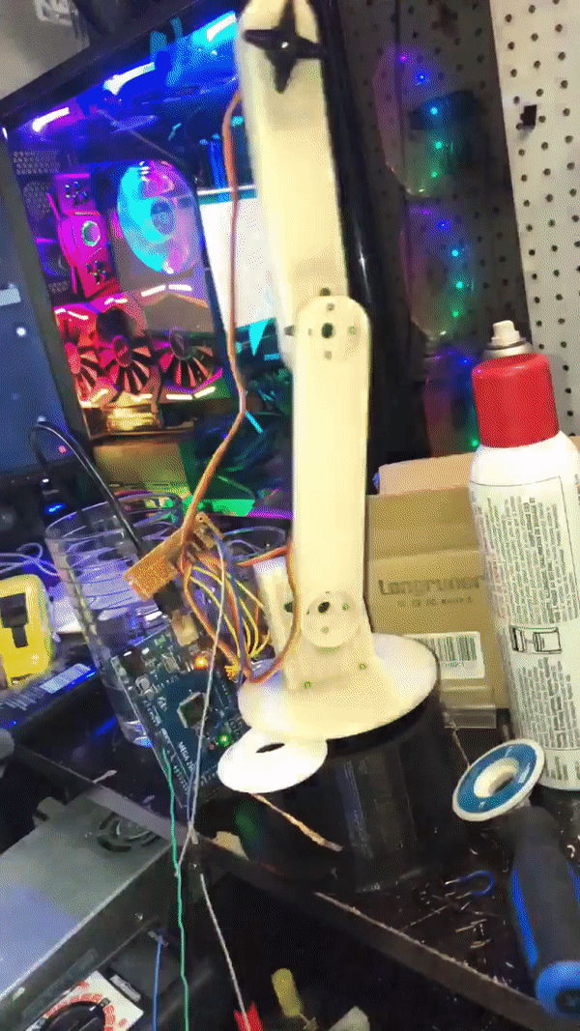
3D Printing Most parts
After modeling all parts, most of the robotic arm is 3D printing and assembled together. All RC servos were screwed into place and the arm assembled. Also, the arm was program with a test code to dance back and forth to make sure all servos worked and everything will move smoothly. After, buttons were hooked up to control the servos manually.

Slide 14
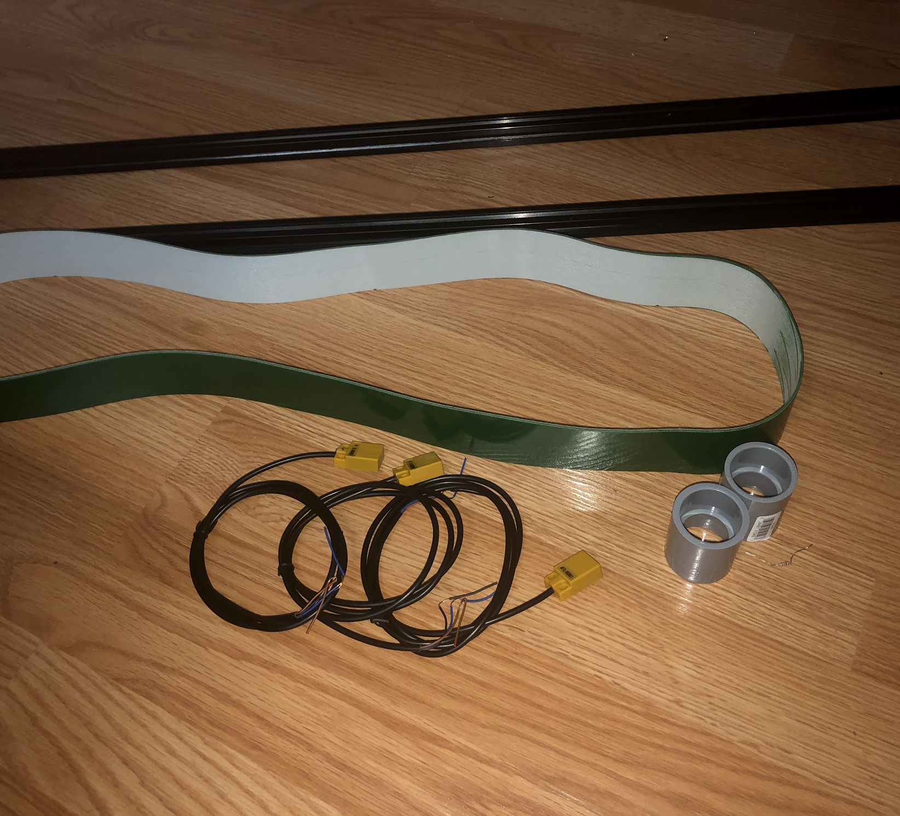
Getting the conveyor Ready
A stepper motor will be driving the conveyor belt. The belt will be about 70cm long and about 5cm wide. Proximity sensors will be along side or underneath the conveyor to detect the metal part. A test program was created to test all proximity sensors and rotate the stepper moter.

Slide 15
Next Milestone – Building the conveyor
The next immediate goal needed is to create and move the conveyor belt. 3D printed parts have to be made to hold up the rollers and a motor mount has to be created.

Slide 16
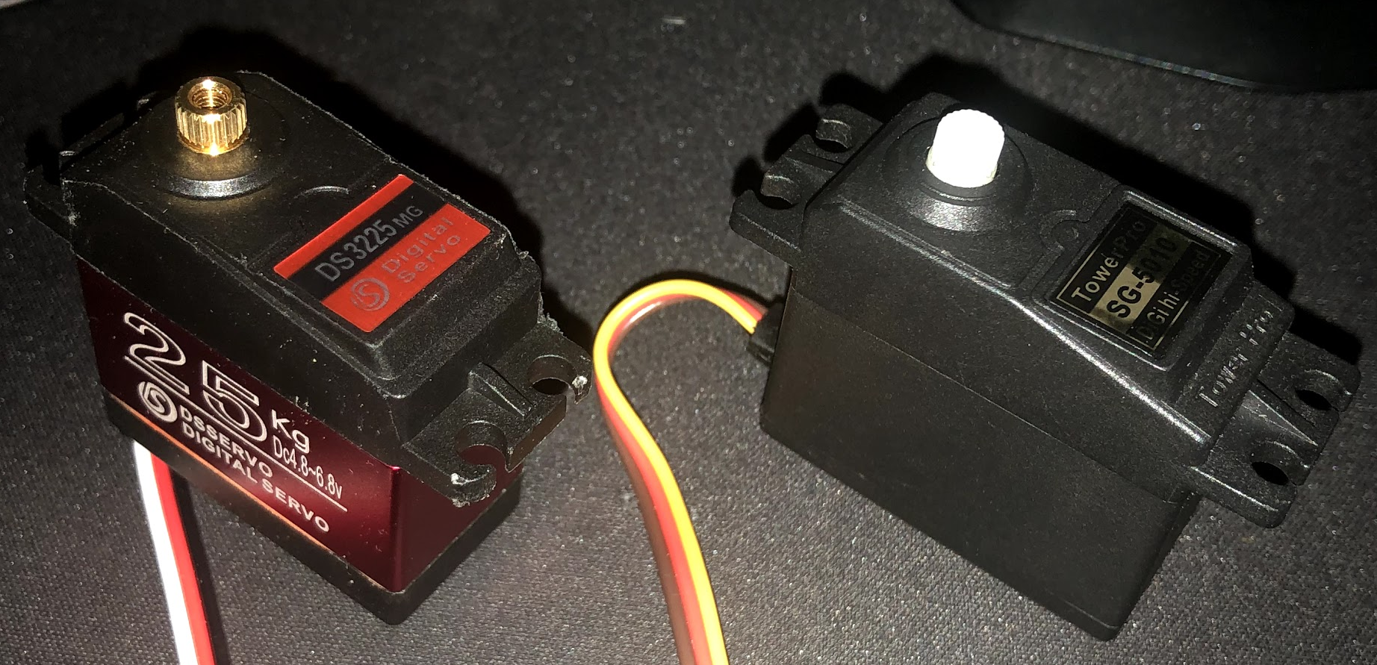
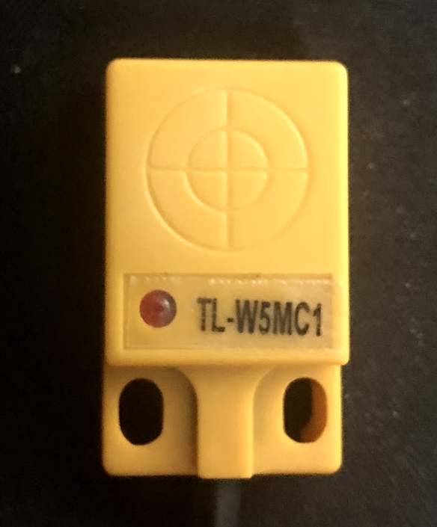
Problems to date
RC Servos
Wait Times
Proximity Sensors
Some RC servos I had ordered are do not have enough torque. I had purchased a stronger servo and it works without flaws.
Ordering cheaper products comes at a cost of time. When I have purchased some products such as my conveyor belt, it has taken several weeks to come in.
The proximity sensors I have ordered only have a detection distance of 5mm. If the mount is placed under the conveyor, it may not be strong enough to detect the metal part.

Slide 17
Potential Risks
Some potential risks that can be with my project are:
Conveyor belt slips or drifts to one side
Arm may not be strong enough to pickup part
Unable to program are to pickup while moving

Slide 18
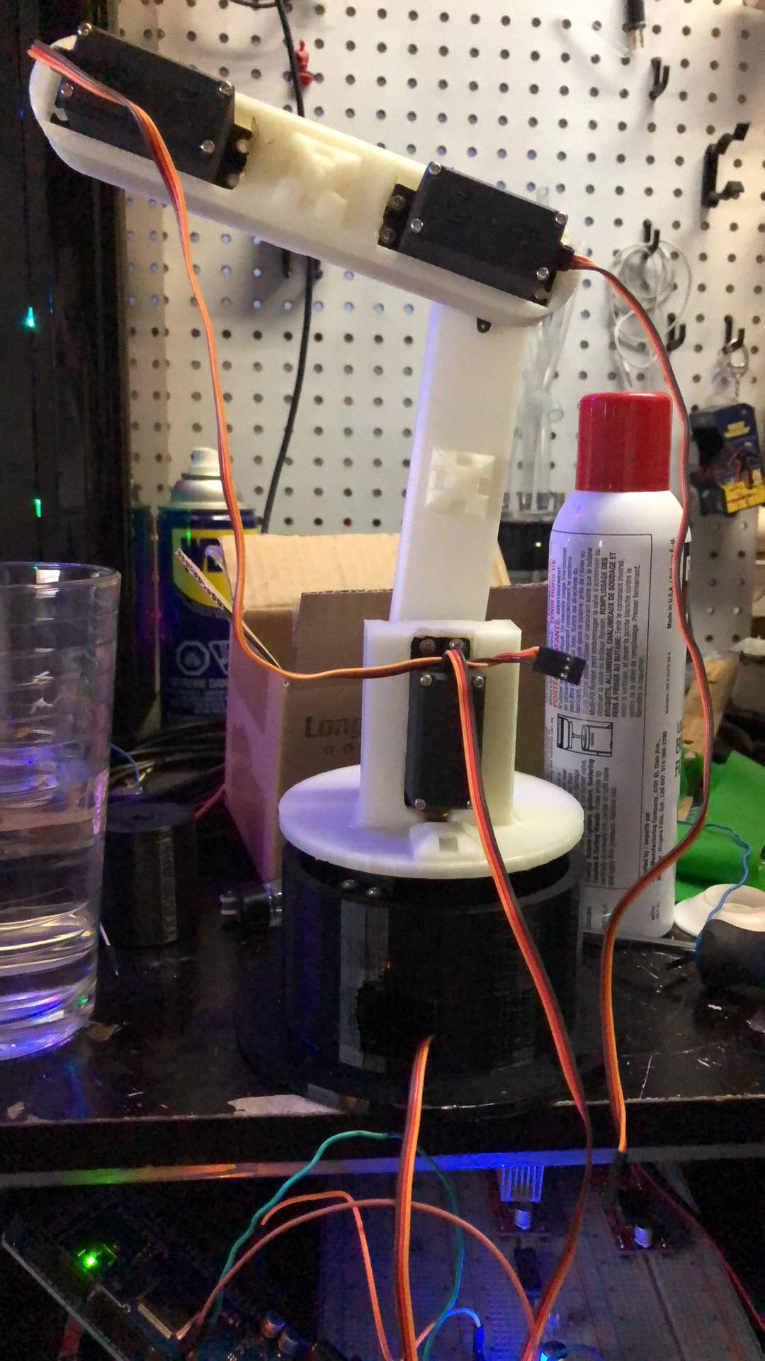
Conclusion
So far, the articulating robotic arm is going as planned. Everything is coming together nicely and running smoothing. There has been some bumps in the road but so far overcome. The mechanical build of the project should be done within the next couple of weeks. This should allow me to start the electrical portion and then programming relatively soon.

Slide 19
Thank You for listening

